Slide 1


Carry Disregard Approximate Multipliers
April 16, 2024
Dilli Babu Porlapothula-MS2023005
Yogesh Goyal - IMT2021542
Akash Perla - IMT2021530
Vaibhav Tiwari - MT2023524
Pratikkumar AshokKumar Solanki - MT2023527

Slide 2
CONTENTS
INTRODUCTION
BACKGROUND
RELATED WORKS
PROPOSED WORK
ACCURACY CRITERIA
SYNTHESIS RESULTS
IMAGE PROCESSING APPLICATION
FUTURE WORK
REFERENCES

Slide 3
Introduction
Multiplication is one of the most common numerical operations and conventional exact multipliers have significant critical path delays, area and power consumption.
Approximate computing to improve performance in computing systems.
Leveraging human perceptual limitations to allow for approximations in error-tolerance applications like Image Processing and Multimedia.
We propose N-bit approximate array multipliers based on carry-disregarding.

Slide 4
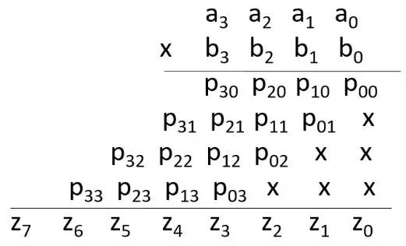
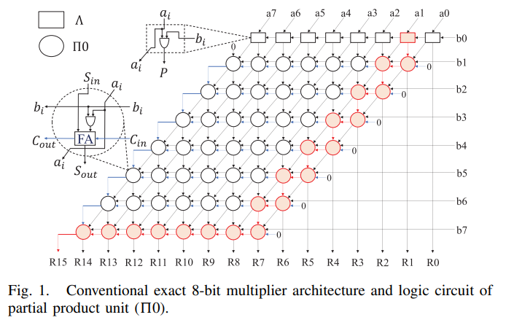
Background
Multiplication consist of three main computation stages: Partial Product (PP) generation, PP reduction and final addition.
We can employ approximation in any of these 3 stages.
Array multiplier is similar to how we perform multiplication with pen and paper i.e. finding a partial product and adding them together.

Slide 5
Related works
Tree-based structures like the Wallace and Dadda trees, which offer lower delay but consume more power and area compared to array-based designs and higher complexity .
Additionally, Operand truncation (Truncating the input operands from N − 1 bits to h bits) reduces the size of adders and bit-width shifters. Hence, design metrics such as area, delay, and power decrease, while output error increases.
The array-based multiplier's benefits: straightforward, uniform, modular architecture, and typically less power consumption and area .
By integrating carry disregarding in array multipliers and refining the logical functions, we achieve significant improvements in critical metrics such as delay, power consumption, and area utilization compared to previous methods.

Slide 6

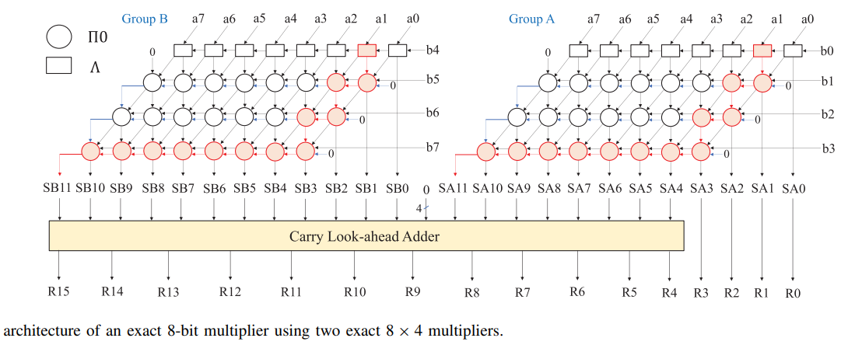
Proposed Work
By distributive property we can convert large scale multiplications into smaller one. we can convert exact 8 bit multiplication to two 8*4 multiplication.
A, B are 8 bit and BH and BL are MSB &
LSB bits.
The two 8*4 multipliers operate
Parallely reducing critical path delay.
But still the dependency on carry exists
Between π0 blocks.

Slide 7
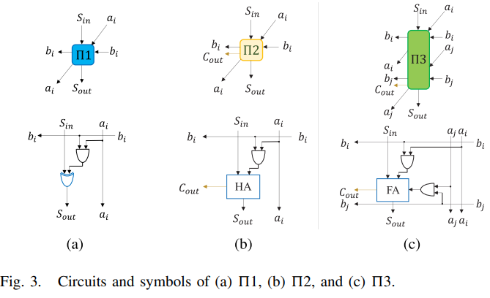
Approximate Partial Product(PP) units
Carry Disregard PP Unit (π1): 1 AND gate for 1bit mul & 1 XOR gate for determining the sum of Sin. No Cin and Cout.
Half-adder-Based PP Unit (π2): 1AND gate, 1 HA for finding the sum of Sin with Λ output.
It has Cout but disregards Cin.
Full-adder-Based PP Unit (π3): 2 AND gates
1 FA for finding the sum of Sin with 2Λ output.
It has Cout but disregards Cin. It is a combination of 2 π0's but reduces to only 1 Cout.

Slide 8
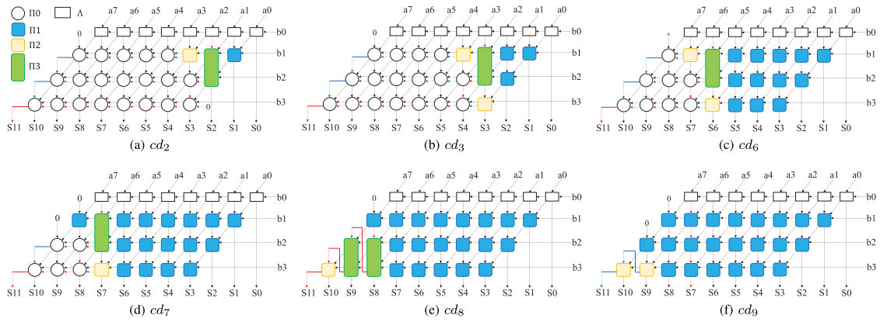
Proposed Approximate 8*4 Multipliers
The cd3 disregards all the carries up to Column 3, so all the elements up to this column are π1 type. In Column 4, there is an π3 and an π2. Column 5 also contains an π2, so other elements of this multiplier are π0s.
The other cd2,cd6,cd7
Cd8,cd9 follows similar
Procedure.

Slide 9
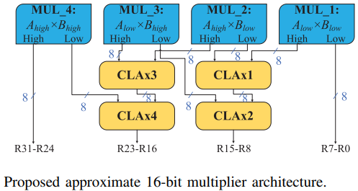
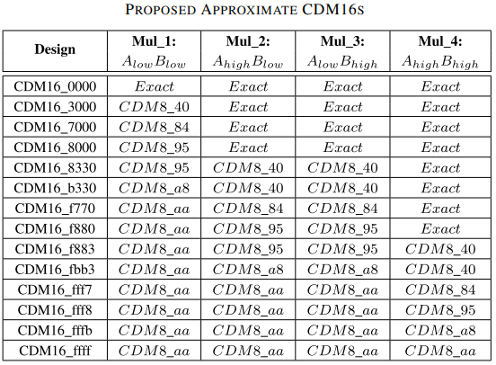
Proposed Approximate 16 bit Multiplier

Slide 10
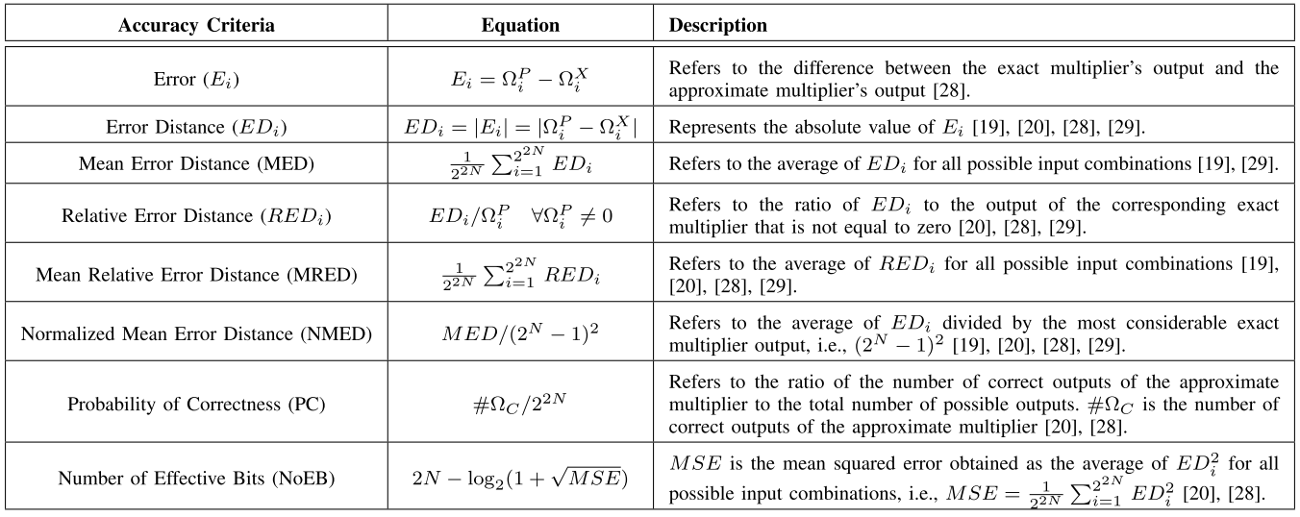
ACCURACY CRITERIA

Slide 11
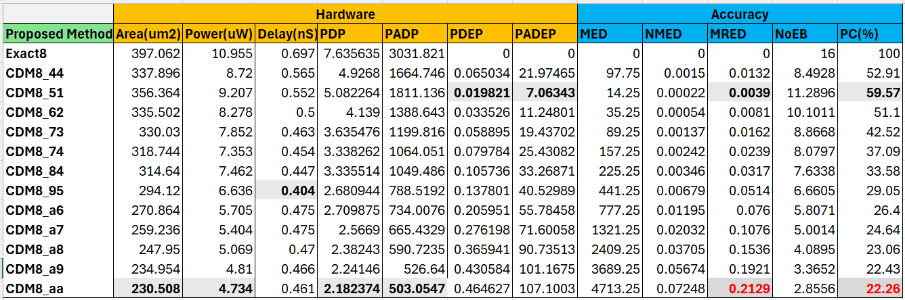
RESULTS For 8 bit Multipliers
We used Verilog HDL to describe the proposed approximate multipliers and Genus tool was used to synthesize the proposed designs with 45-nm technology to get critical path delay, power consumption, and area.

Slide 12
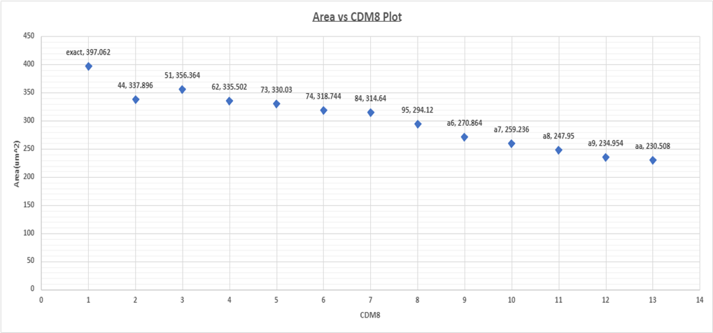
Area Graph

Slide 13
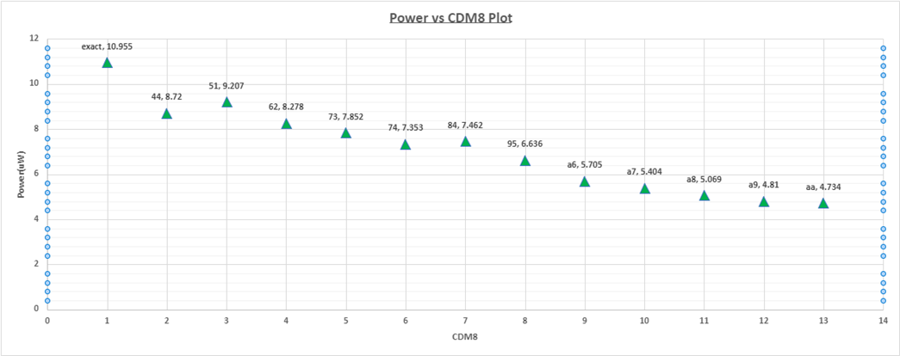
Power Graph

Slide 14
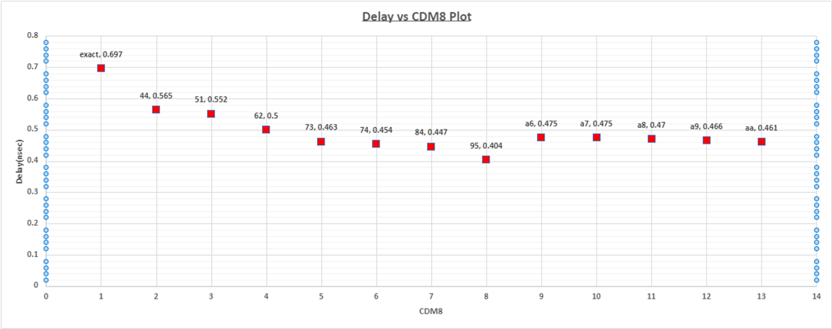
Delay Graph

Slide 15
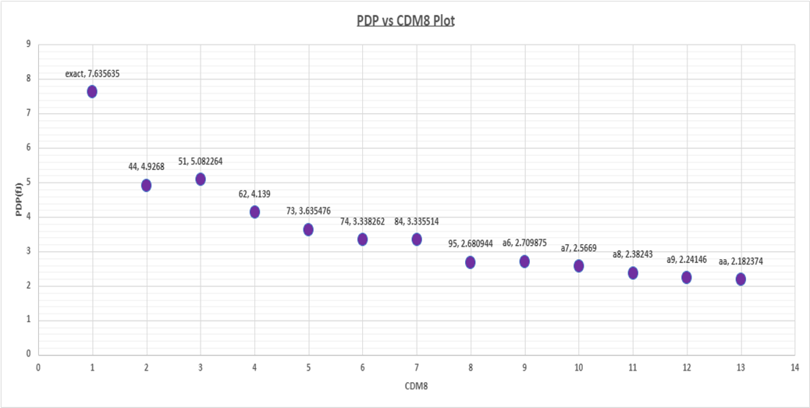
PDP Graph

Slide 16
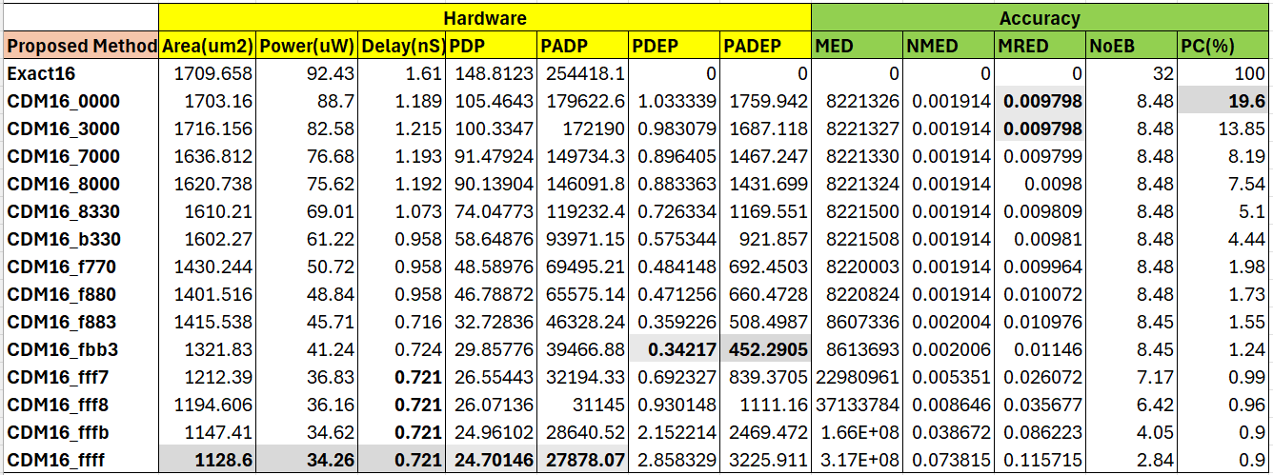
RESULTS For 16 bit Multipliers

Slide 17

APPLICATION: Image Processing
We assess the use of Image blurring in Image Processing using Gaussian Smoothing.
The 3*3 kernel used for gaussian smoothing with σ=1.5 is
Performance Metrics:
Peak Signal-to-Noise Ratio (PSNR): PSNR measures the quality of an image by evaluating the mean squared error between the original and reconstructed images.
Structural Similarity Index Measure (SSIM): SSIM quantifies the similarity between two images based on luminance, contrast, and structure, reflecting human perception of image quality.

Slide 18
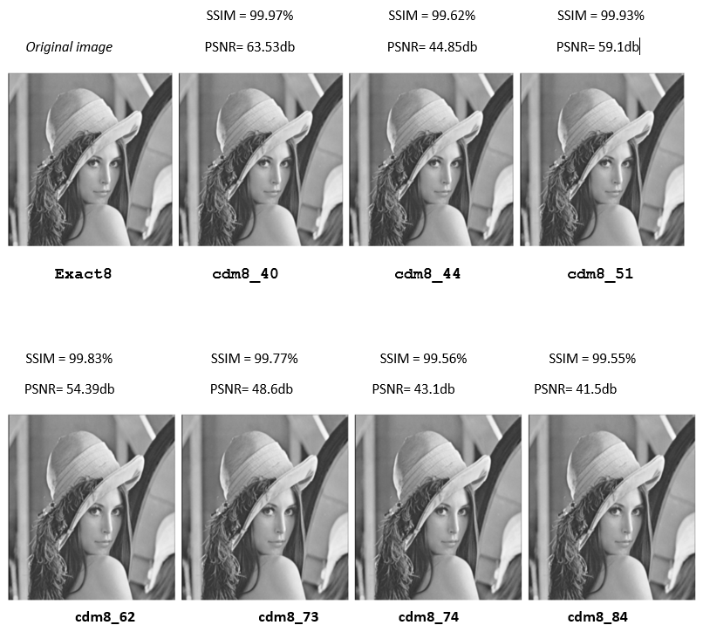

APPLICATION: Image Processing

Slide 19
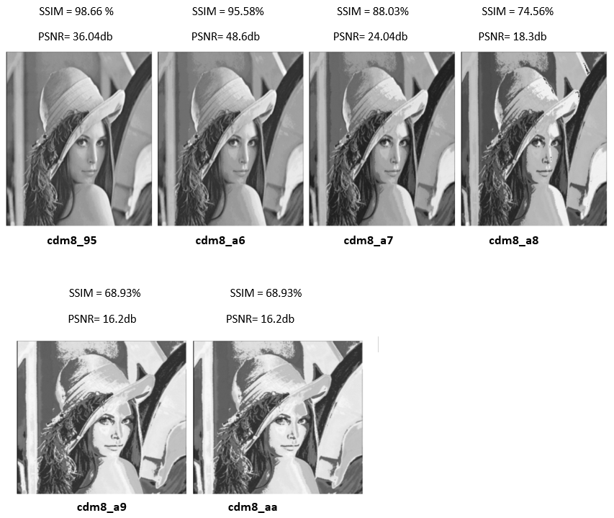
APPLICATION: Image Processing

Slide 20
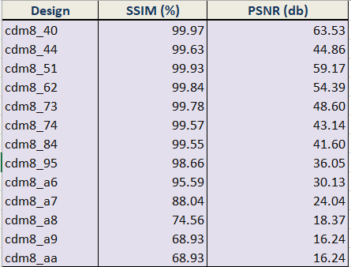
APPLICATION: Image Processing

Slide 21
Future Scope
we plan to use compressor based multi-operand approximate adders in the process of PP reduction.
For the final summation step in the process of multiplication, there are various types of adders, such as CSA and Parallel Prefix Adder (PPA), can be done for future work.
Different applications have different error tolerances, so dynamically adjusting the accuracy level of the proposed multipliers in various applications is one of our future works

Slide 22

RESULTS SCREENSHOTS & Code

Slide 23
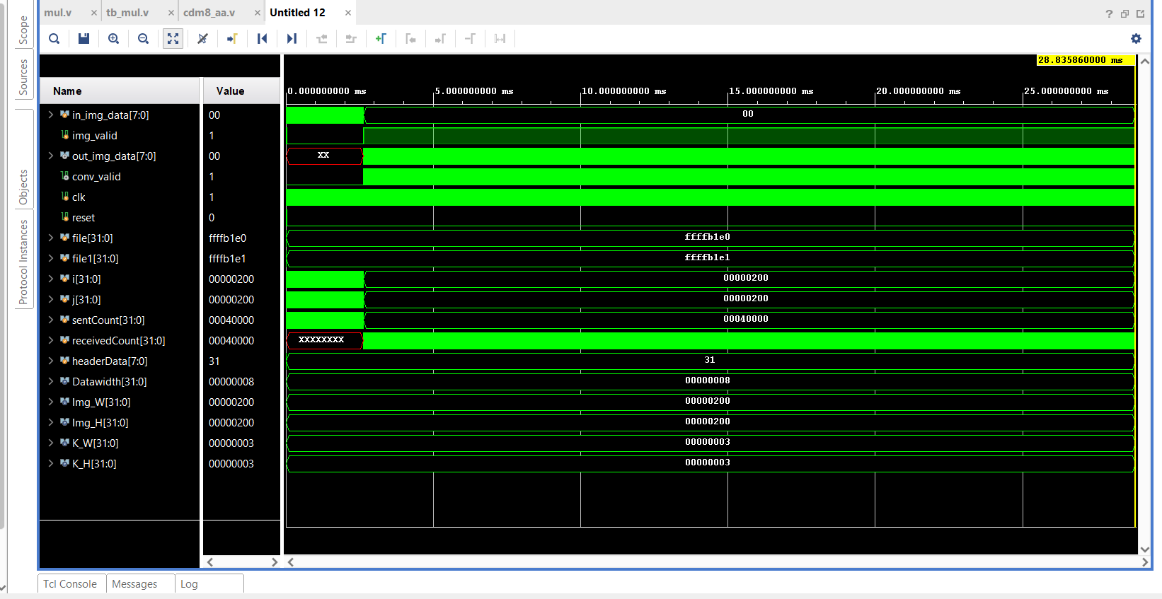
IMAGE PROCESSING VERILOG SIMULATION

Slide 24
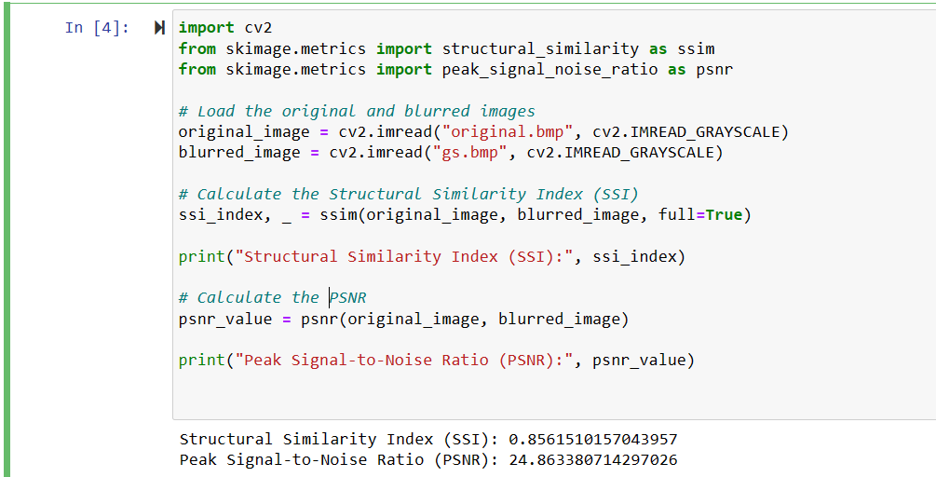
IMAGE PROCESSING – Python code for PSNR & SSIM

Slide 25
GITHUB
https://github.com/Akash-Perla/Carry-Disregard-Approximate-Multipliers

Slide 26
REFERENCES
W. Liu, F. Lombardi, and M. Shulte, “A retrospective and prospective view of approximate computing point of view,” Proc. IEEE, vol. 108, no. 3, pp. 394–399, Mar. 2020.
P. Schober, S. N. Estiri, S. Aygun, N. TaheriNejad, and M. H. Najafi, “Sound source localization using stochastic computing,” in Proc. IEEE/ACM Int. Conf. Comput. Aided Design (ICCAD), Oct. 2022, pp. 1–9.
N. TaheriNejad and S. Shakibhamedan, “Energy-aware adaptive approximate computing for deep learning applications,” in Proc. IEEE Comput. Soc. Annu. Symp. VLSI (ISVLSI), Jul. 2022, p. 328.
P. Schober, S. N. Estiri, S. Aygun, A. H. Jalilvand, M. H. Najafi, and N. TaheriNejad, “Stochastic computing design and implementation of a sound source localization system,” IEEE J. Emerg. Sel. Topics Circuits Syst., vol. 13, no. 1, pp. 295–311, Mar. 2023.

Slide 27


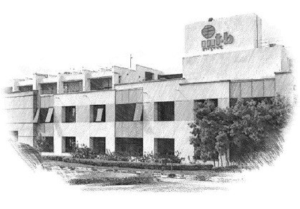






International Institute of Information Technology Bangalore
26/C, Electronics City, Hosur Road, Bengaluru – 560 100, Karnataka, India www.iiitb.ac.in
https://www.facebook.com/IIITBofficial/
https://twitter.com/IIITB_official
https://www.linkedin.com/school/iiit-bangalore/
https://www.youtube.com/user/iiitbmedia
https://www.instagram.com/iiitb_official/
37

